Slide 1
Module 3 Bezier Curve

Slide 5
In the early 1960s, P. Bezier (Renault - Franch car company) started working on it to give the designer greater flexibility than the interpolating techniques.
Bezier curves employ control points (control vertices), i.e. an ordered set of points (V0, …, Vn) that approximate the curve.
Bezier started with the principle that any point on a curve segment must be given by a parametric function of the foll. form
P(u) =
where Pi represents n+1 vertices of a
characteristic polygon. Vertices are the
control points
Bezier then set forth the properties of the f_{i} basis function must have
The function must interpolate the first and the last vertex point
The tangent should be defined by Pn – Pn-1
Curvature continuity is determined by neighbouring vertices
The function must be symmetric between u and 1-u

Slide 6
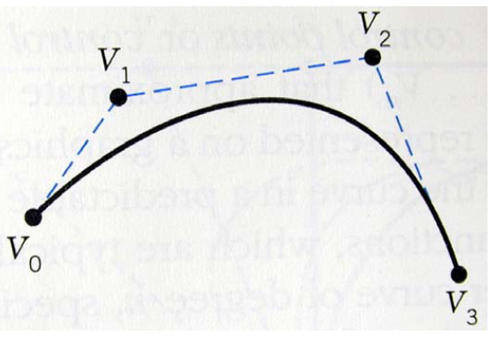
Bezier chose a family of function called Bernstein Polynomials to satisfy these properties.
He chose a form of vector representation that used the sides of the characteristic polygon, ie the number vertices selected to specify the curve
A Bezier curve of degree n, specified by n+1 control points, thus the designer can have control over the input points and the output curve. And is not dependent on the tangent vector
The order of the Bezier curve is variable and is related to number of points ie n+1 define the nth degree curve, which permits higher order continuity.
Only the first and the last control points or vertices of the characteristic polygon lie on the curve
The curve is always tangent to the first and last polygon segments
Curve shape tends to follow the polygon shape

Slide 7
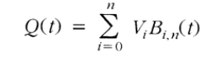
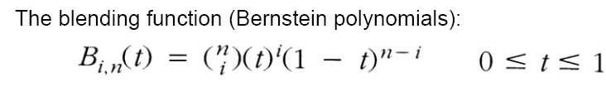
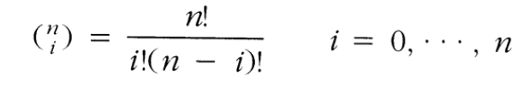
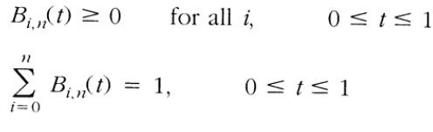
The parametric function:
1
2
where n is the degree of the polynomial and the binomial coefficient:
3
These blending functions satisfy the following conditions:
4
5

Slide 8
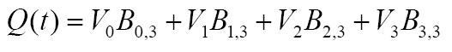
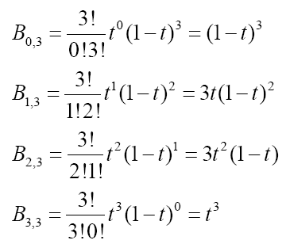
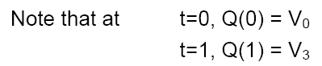
Consider the case of four control points V0, V1, V2, V3, since n+1 = 4, the degree n of the polynomial is 3.
Expanding Eq. 1 yields
Four blending functions must be found based on the Bernstein polynomial given in Eq. 2

Slide 9
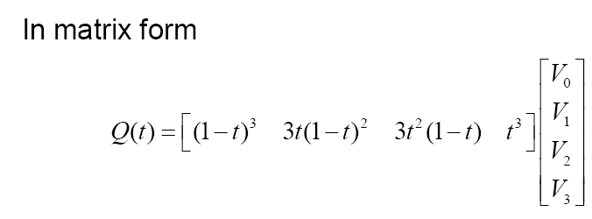
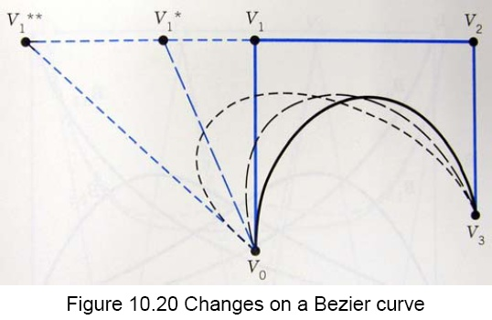

Slide 10
Properties of Bezier Curve
1.The interpolates first and last control points
2.The curve is symmetric with respect to u and u-1 that means the sequence of points can be reversed without changing curve shape. When u=1/3 then u-1=2/3. B_{i,3} and B_{n-I,3} are symmetric
3.The curve is tangent to first and last segment of Bezier polygon
4.At any value, blending function are non zero ie B_{i,n}(u) > 1
5. B_{i,n}(u) has a maximum value at u = 1/n. Therefore each control point is weighted by its blending function for each value of u
For eg at i=1 , n=3 , u=1/3 ; B_{1,3 =} 4/9
A closed Bezier curve can be generated by choosing P₀ and Pn to be coincident ie P₀=Pn
6. The curve shape can be modified by changing one or more vertices of the polygon

Slide 11
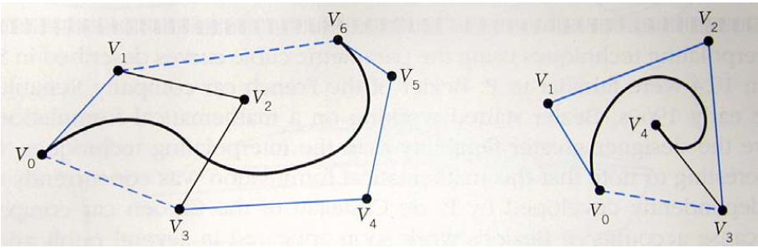
7. The eqs. (5) is called the “normalizing property”.
ie partition of unity is one
These conditions force the curve to lie entirely within the convex figure set by the extreme points of the polygon formed by the control points, called the convex hull.
Convex hull property – which helps for manipulation of curve easily and also helps while handling activities like segmentation, clipping, intersection, trimming etc
8.Curve is very smooth and flexible

Slide 12
Limitations of this curve
The curve lacks local control ie by changing position of one vertex whole shape of the curve changes
Curve doesn’t pass through all the control points which may be inconvenient to some designers
For changing the degree of the curve, we need to increase the number of vertices or to reduce degree of curve we have reduce number of control points. Thus degree of curve is dependent upon number of vertices of bezier polygon

